Slide 1
Test Demo
Khoa - webdeveloper

Slide 2
Technical
Backend:
Python (flask framework)
Frontend:
Vue framework
CSS: Bootstrap framework to responsive
Database:
Mysql (MariaDB version: 10.4.11-MariaDB)
OS: window
Create single page web application.

Slide 3
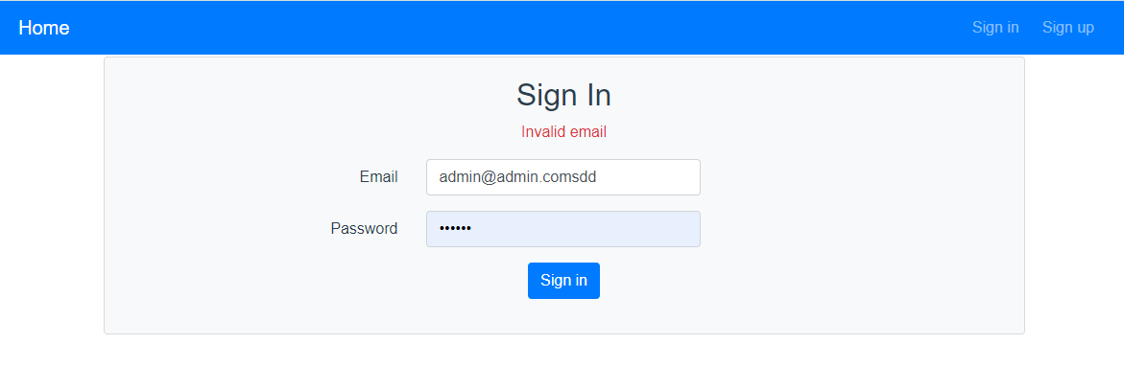
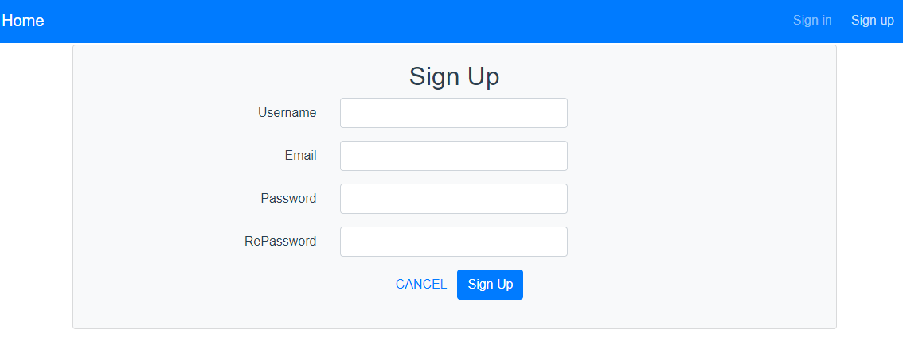
The user can sign up, sign in, and sign out.
When user never login → first page is sign in
When user logged in, redirect to home
When user click button Signup, redirect to sign up page

Slide 4
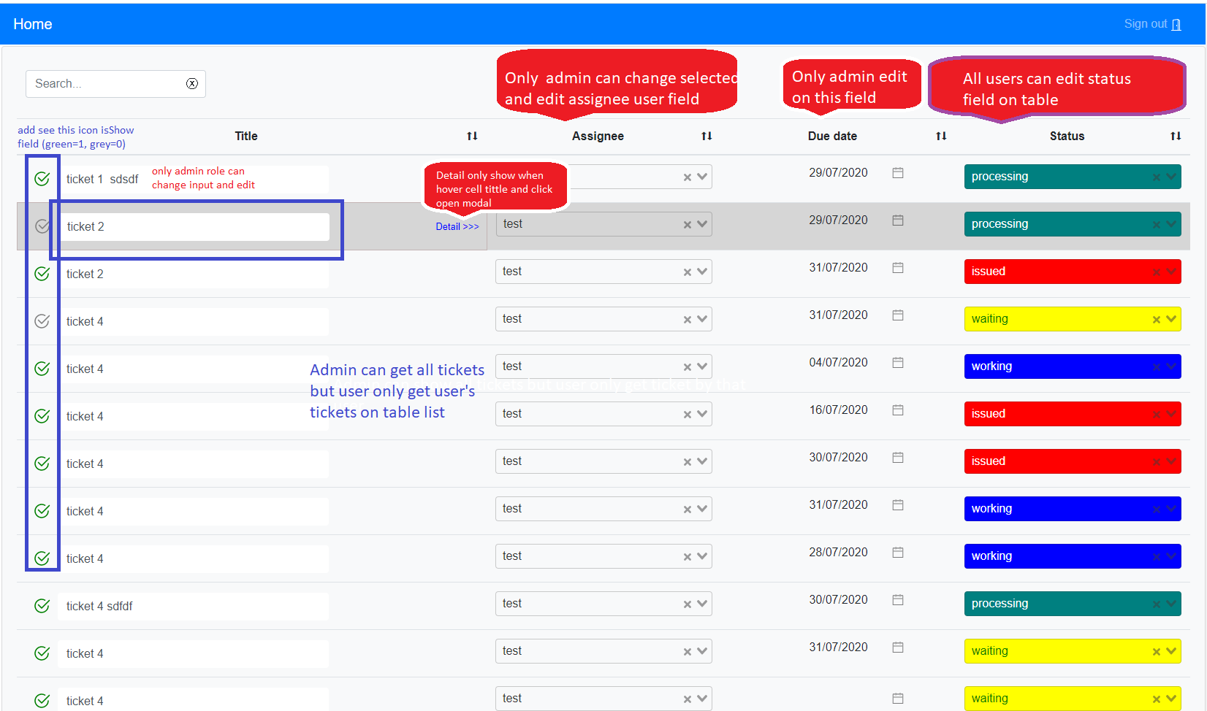
Feature
Admin can edit all fields on table but user only change status field

Slide 5
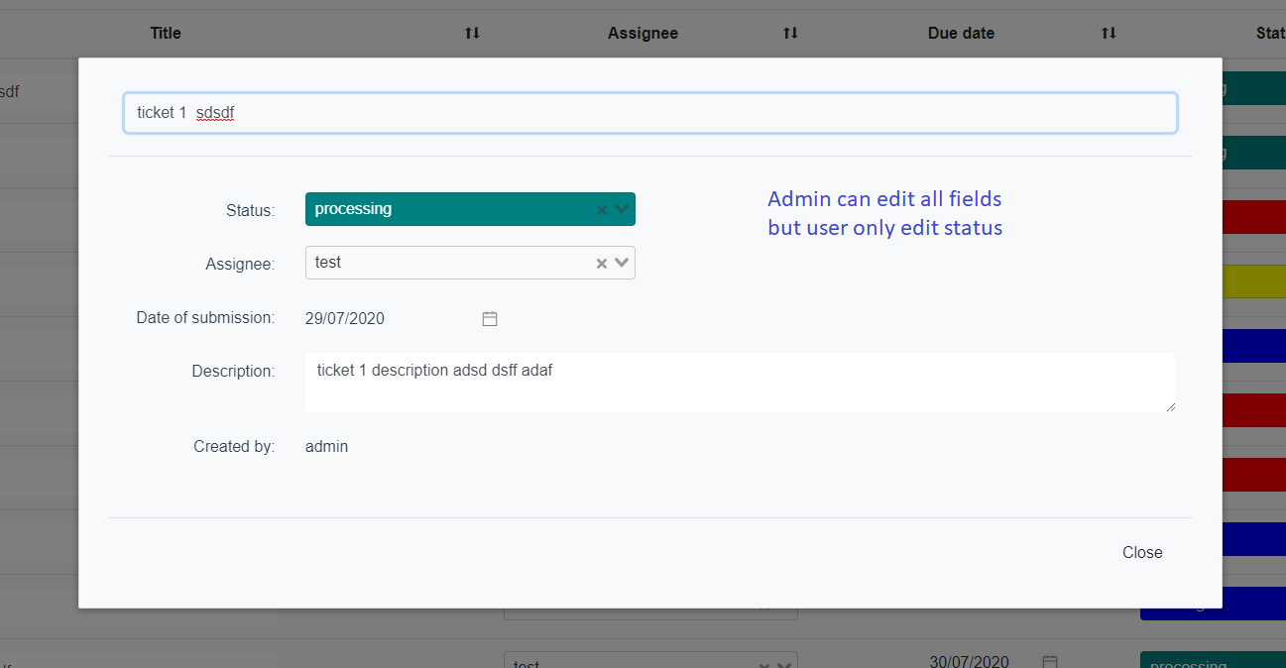
Show modal detail ticket
Admin can edit all fields on table but user only change status field.

Slide 6
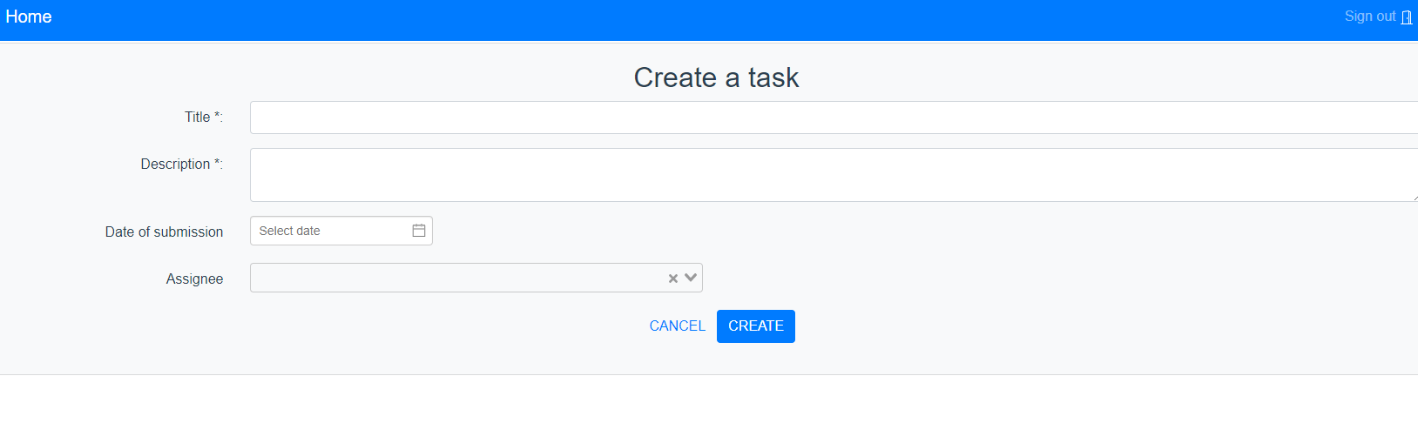

Create ticket page
Click button add task on table header tools to redirect to create ticket page.
2 fields required to create a ticket:
Title
Description

Slide 7
Log to file log
Use python plugin logging

